Slide 1
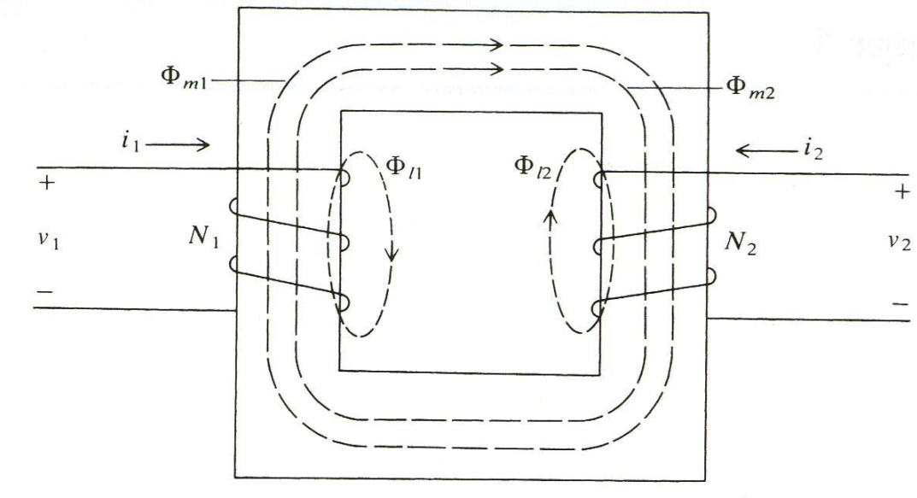
1. Magnetically Coupled Circuits

Slide 2
voltage equations
flux linkage equations

Slide 3
define inductances
Note: L₁₂ is always equal to L₂₁
then

Slide 4
Coupled Circuit Model

Slide 5
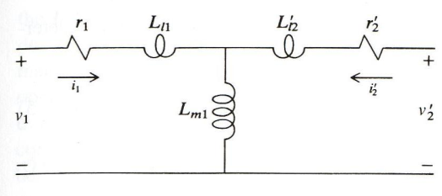
Refer Secondary to Primary with N₁/N₂
voltage equations
flux linkage equations

Slide 6
Refer Secondary
with Arbitrary Turns Ratio

Slide 9
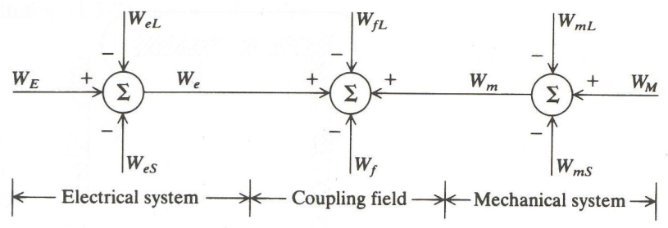
2. Energy Conversion
W_{E} - electrical energy input
W_{eL} - electrical energy losses (resistance)
W_{eS} - stored electrical energy (leakage inductance)
W_{M} - mechanical energy input
W_{mL} - mechanical losses (friction)
W_{mS} - stored mechanical energy (springs, masses, etc.)
W_{fL} - field energy losses (hysteresis, eddy-currents, etc.)
W_{f} - energy stored in the coupling field

Slide 10
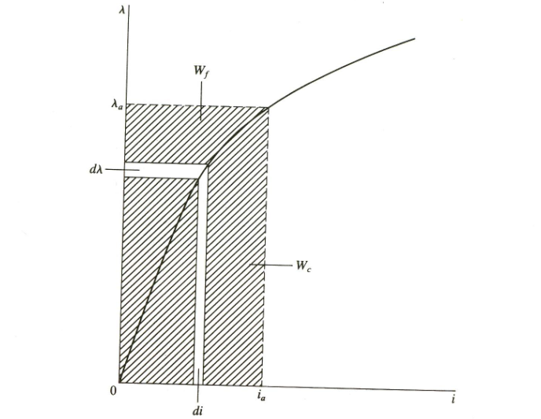
Energy
W_{f} - field energy
W_{c} - co-energy

Slide 11
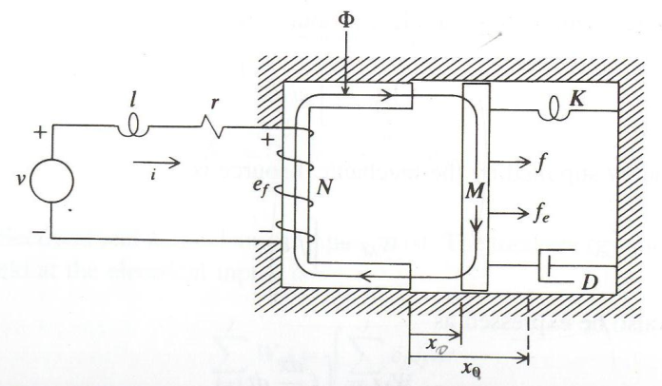
Example Electromechanical System
electrical equations
mechanical equations
W_{eL}
W_{eS}
W_{e}
W_{mL}
W_{m}
W_{mS}

Slide 12
Energy Balance Equation
Neglecting W_{fL},
then,
grouping terms

Slide 13
Field Energy
for our example system,

Slide 14
Example System Inductance

Slide 15
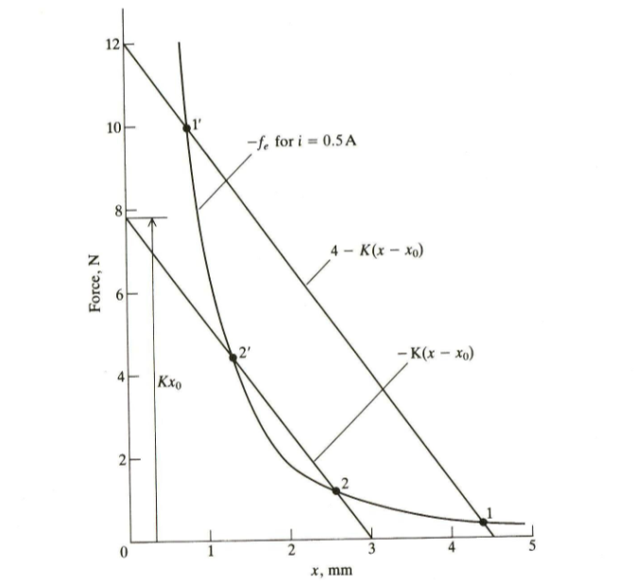
Steady-State Calculations
steady-state operation
(stable points 1 and 2)

Slide 17
Simulation Diagram (Matlab Simulink)

Slide 18
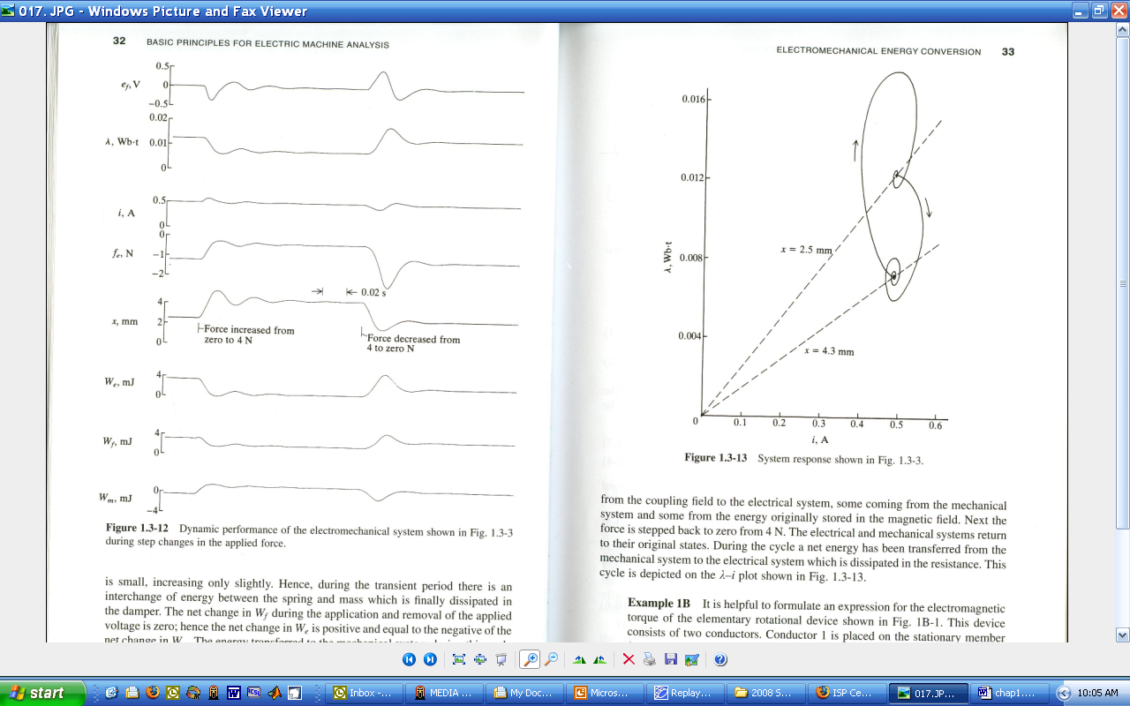
Dynamic Simulation

Slide 19
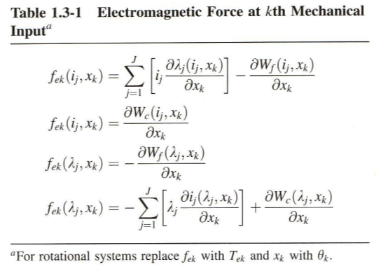

Slide 20
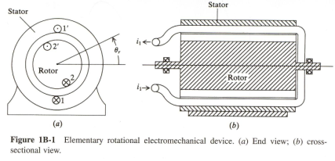
Motor Torque Example
choose i₁, i₂, and θ_{r} as state variables
fix position dθ_{r} = 0

Slide 21
start at (0,0) go to (i₁,0) then to (i₁,i₂)
for a linear system (no saturation)

Slide 22
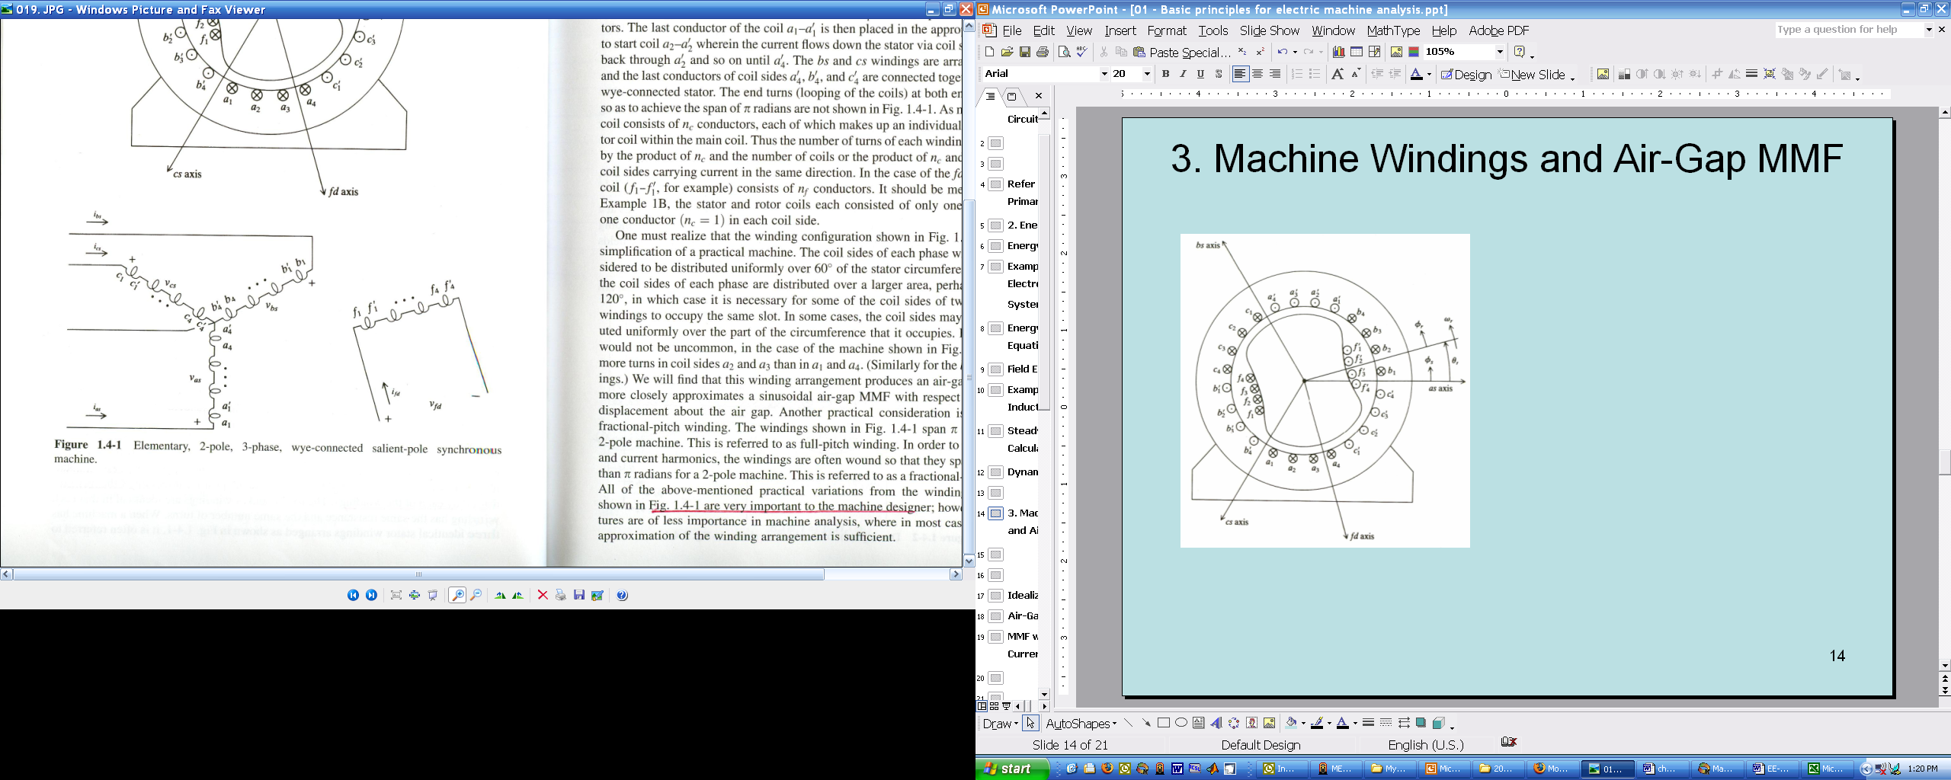
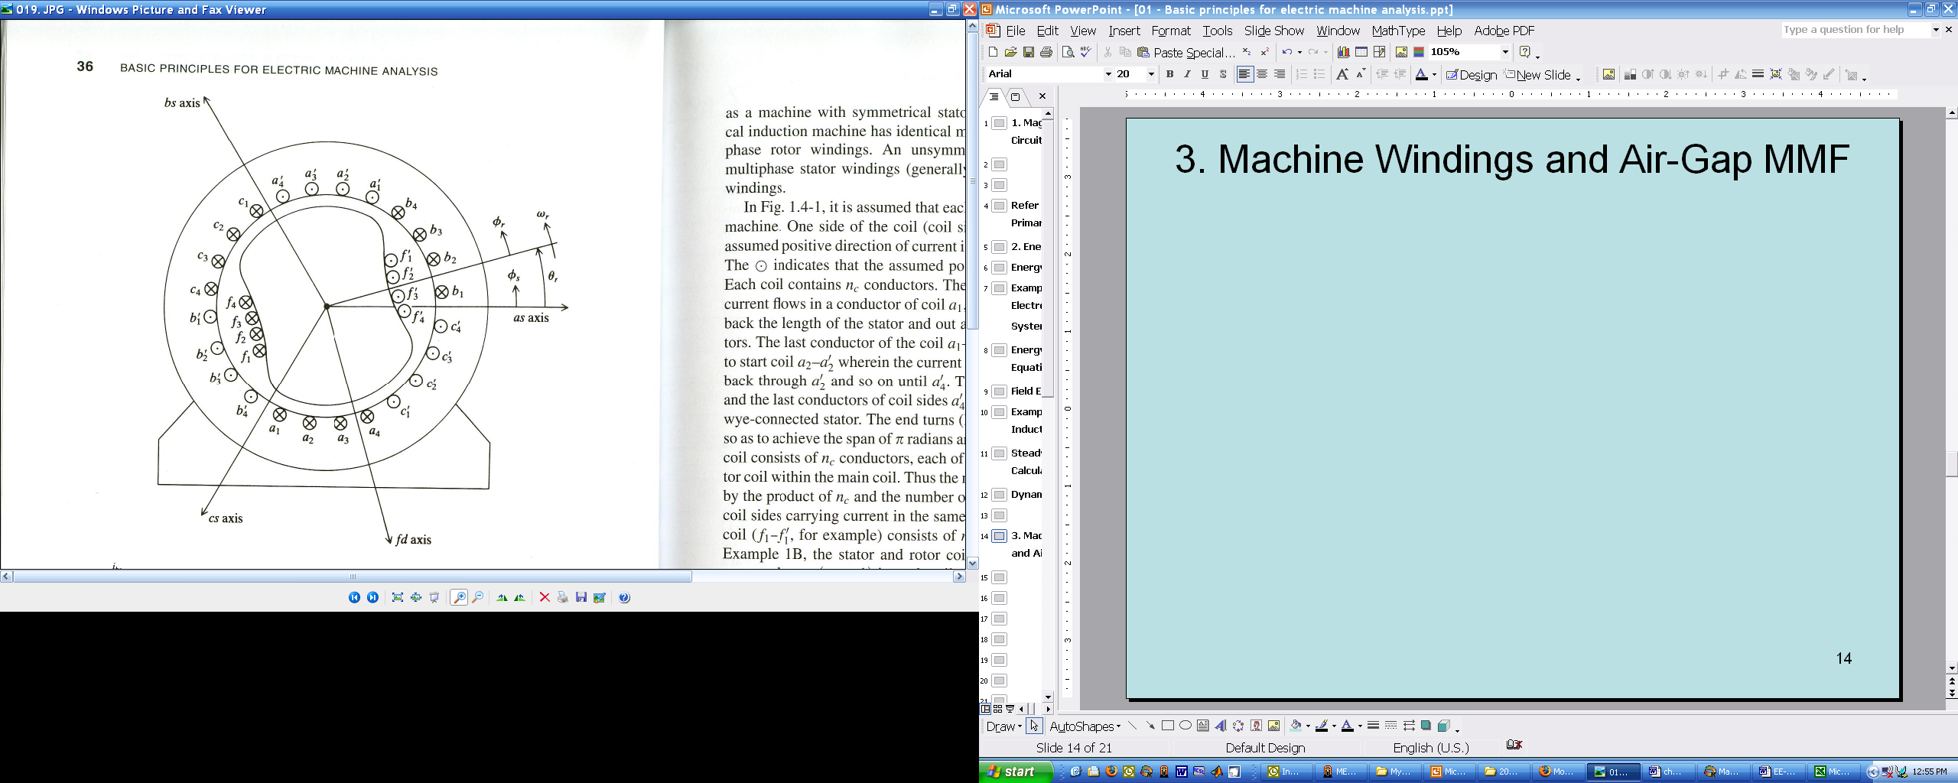
3. Machine Windings and Air-Gap MMF

Slide 23
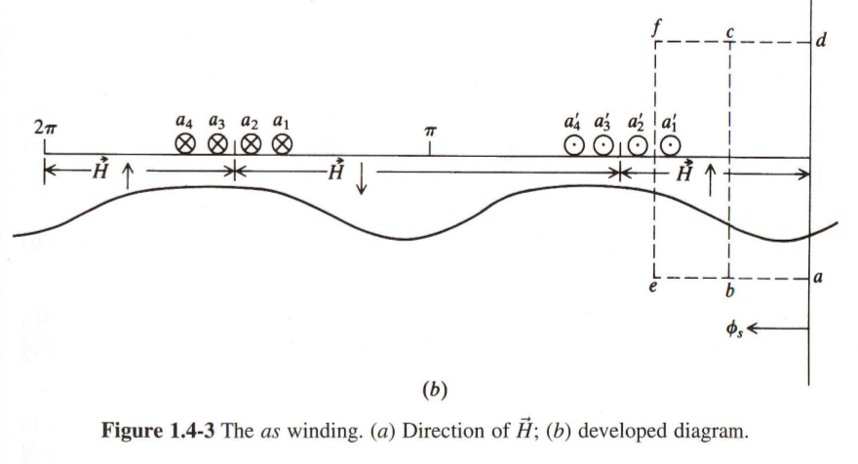
path abcda
path aefda

Slide 24
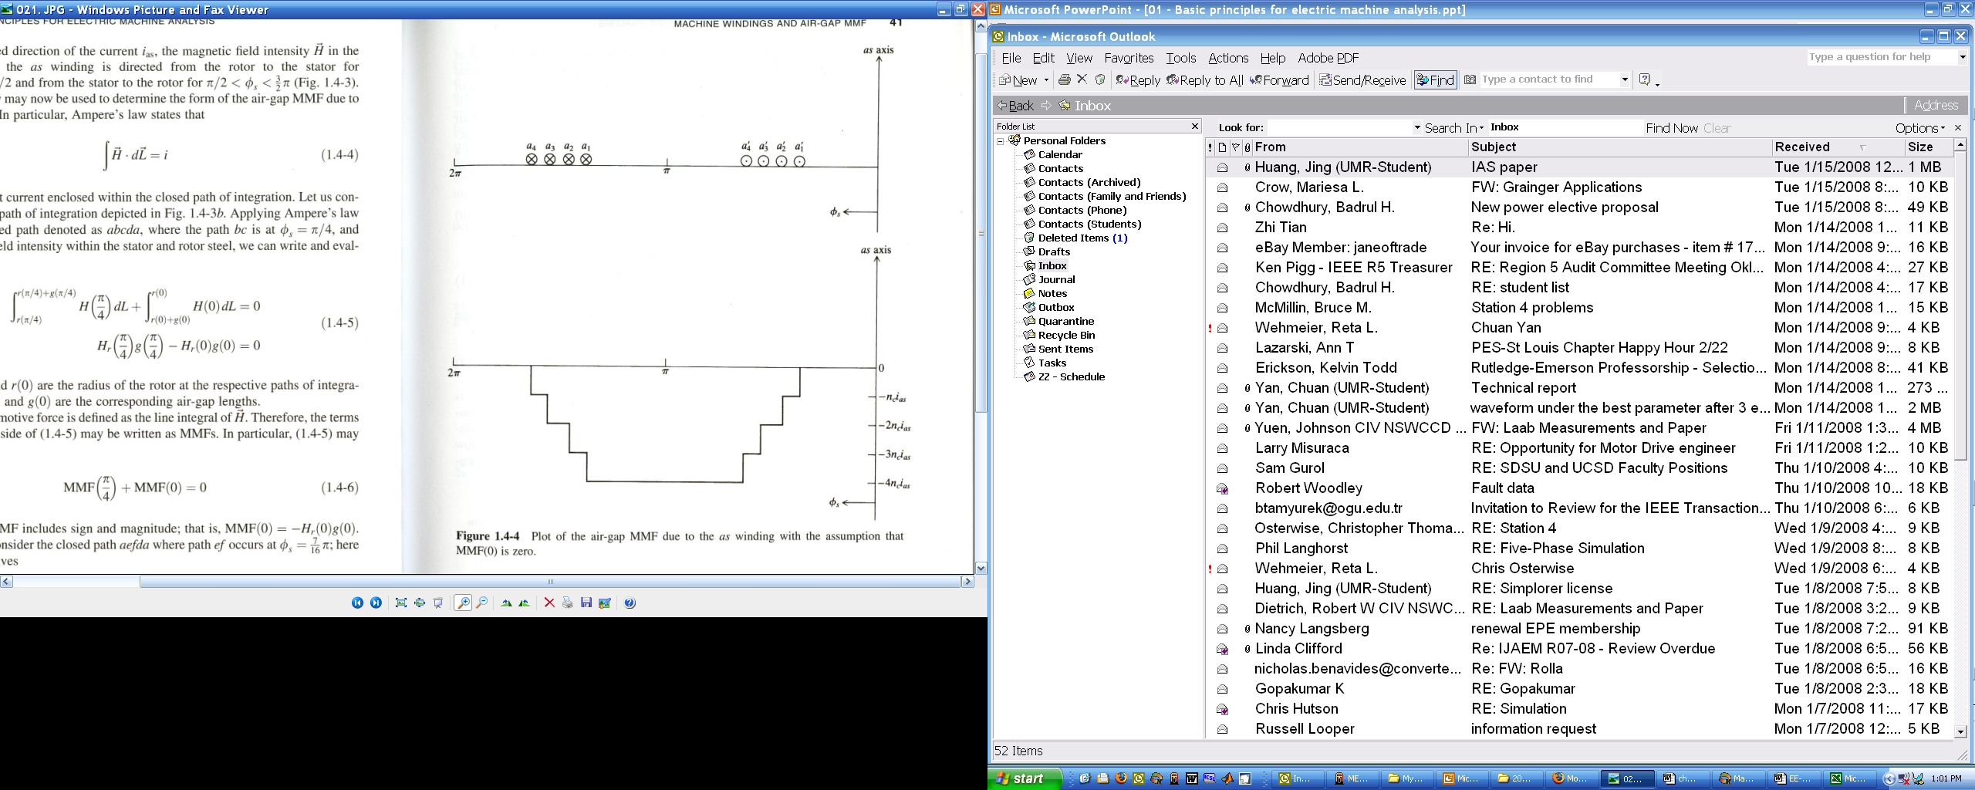
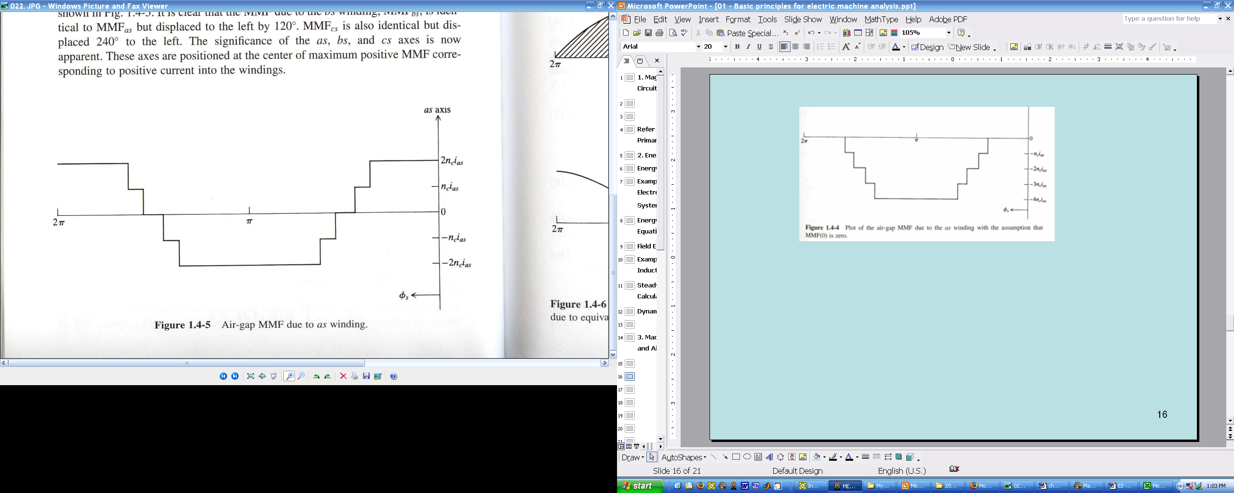
assuming MMF(0)=0
shift up because

Slide 25
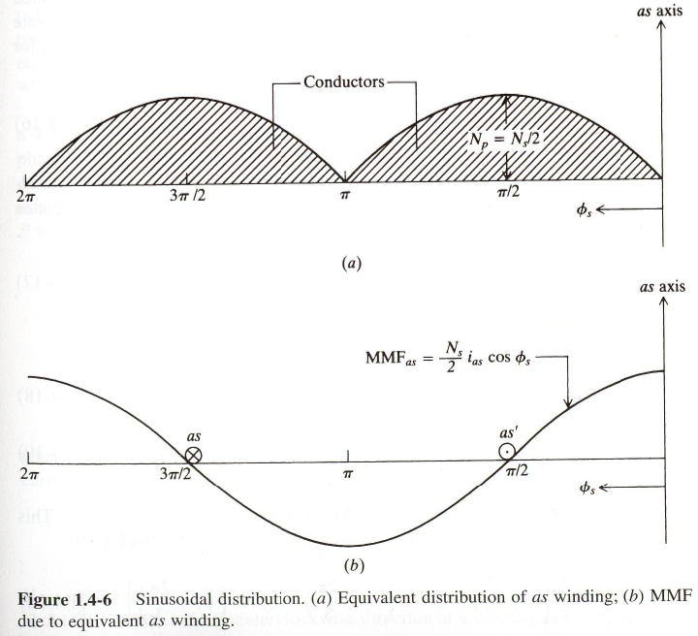
Idealized Machine
integrate turns density to obtain number of turns

Slide 26
Air-Gap MMF
a-phase turns (positive turns into the page)
a-phase MMF
b- and c-phase MMF
total MMF

Slide 27
MMF with Sinusoidal Currents
currents
total MMF
for a machine with P poles

Slide 28
MMF Example

Slide 29
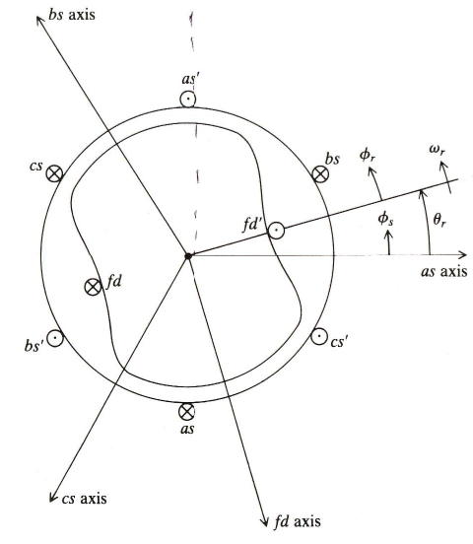
4. Synchronous Machine Analysis

Slide 30

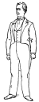
Synchronous Machine
air-gap function
flux density
flux density from the a-phase winding
(1.5-5)

Slide 32
Flux Density due to Field Winding
field turns function in terms of φ_{r} (assume sinusoidal distribution)
field MMF
flux density from the field winding
(1.5-9)

Slide 33
Self Flux Linkage of the a-phase Winding
flux of a winding
flux linking the a-phase due to a-phase current
(1.5-11)
(1.5-12)

Slide 34
Flux Linage: a-phase to Field
flux linking a-phase winding due to field current
(1.5-14)

Slide 35
Full Inductance Formulas
diagonal inductances
off-diagonal inductances

